Slide 1

What is web development !
Web development is to create and maintain websites. They are also responsible for the site's technical aspects, such as its performance and capacity, go in details to see 1 by 1 slide.

Slide 2
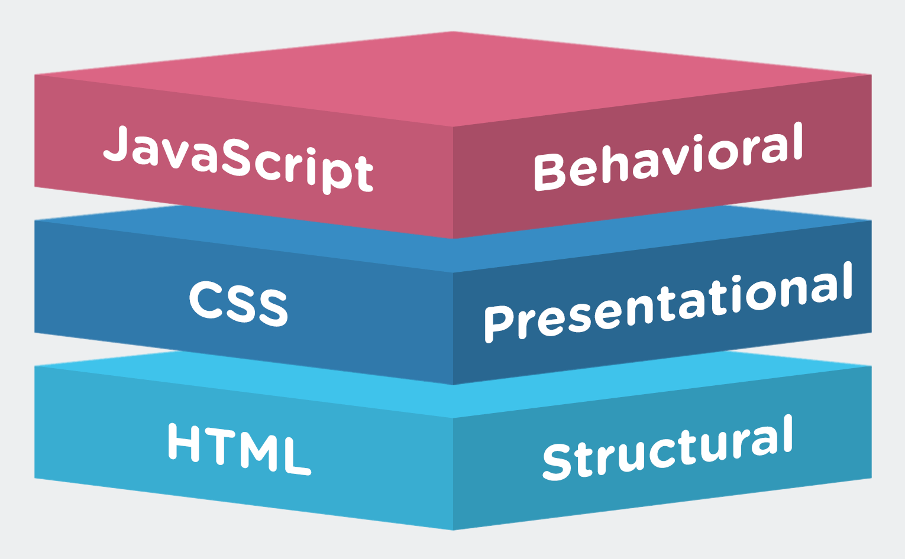

Slide 3
Frontend (HTML / CSS / JS )
Html is use for structure. Like we have to say a human skeleton. It is using for make a web page of a sites
CSS is using for giving a style for a web page. It is used for making a website beautiful.
Js is stand for java script it is used for scripting.it is a programming language. It’s like a other programming language.. It is used for making logics in the web site.

Slide 4
Arrays, 2D Arrays, Sorting
Array is collection of same data type
2d array is like a matrix its also a collection of same data type
Sorting is algorithms for short. It’s a four type
1.Buble sort, 2.slection sort, 3.merge sort and quick sort

Slide 5
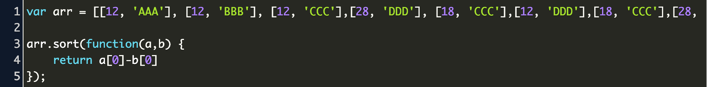
Arrays, 2D Arrays, Sorting

Slide 6
Array:-- The solution is an array! An array can hold many values under a single name, and you can access the values by referring to an index number.
If you have a list of items (a list of car names, for example), storing the cars in single variables could look like this: let car1 = safari; let car2 =Volvo; let car3=BMW However.
what if you want to loop through the cars and find a specific one And what if you had not 3 cars,
2darray:-- assuming a somewhat pedantic definition, it is technically impossible to create a 2d array in JavaScript. But you can create an array of arrays.
which is tantamount to the same. – I. J. Kennedy Jul 29 '14 at 5:05 17 FYI... when you fill an array with more arrays using var arr2D = new Array(5).fill(new Array(3));, each element of Array(5) will point to the same Array(3).
So it's best to use a for loop to dynamically populate sub arrays..
Sorting:-- When the sort() function compares two values, it sends the values to the compare function, and sorts the values according to the returned (negative, zero, positive) value.
If the result is negative a is sorted before b .If the result is positive b is sorted before a .four type of sort in array:-
1.Buble sort, 2.slection sort, 3.merge sort and quick sort

